Slide 1
La transition à l'accès libre par la voie verte﻿﻿
Stevan Harnad
Chaire de recherche du Canada en sciences,
Professeur de psychologie
Université du Québec à Montréal

Slide 2
Qu’est-ce que l’accès libre?
C’est l’accès
gratuit,
immédiat
permanent
en-ligne

Slide 3
La voie verte et la voie dorée
Auto-archivage
Revues accès libre

Slide 4







Impact cycle begins:
Research is done
Researchers write
pre-refereeing
“Pre-Print”
12-18 Months
Submitted to Journal
Pre-Print reviewed by Peer Experts – “Peer-Review”
Pre-Print revised by article’s Authors
Refereed “Post-Print” Accepted, Certified, Published by Journal
Researchers can access the Post-Print if their university has a subscription to the Journal
New impact cycles: New research builds on existing research

Slide 5




Impact cycle begins:
Research is done
Researchers write
pre-refereeing
“Pre-Print”
12-18 Months
Submitted to Journal
Pre-Print reviewed by Peer Experts – “Peer-Review”
Post-Print
is self-archived in University’s Eprint Archive
Pre-Print revised by article’s Authors
Refereed “Post-Print” Accepted, Certified, Published by Journal
More impact cycles:
Researchers can access the Post-Print if their university has a subscription to the Journal
New impact cycles: New research builds on existing research
Notes:
To maximise research access, supplement the existing system:
Do as before, but also:
Self-archive the preprint in your university’s Eprint Archive, so every would-be user can access it.
Self-archive the postprint in your university’s Eprint Archive, so every would-be user can access it.
Research access is maximized and so research impact is maximized.

Slide 6
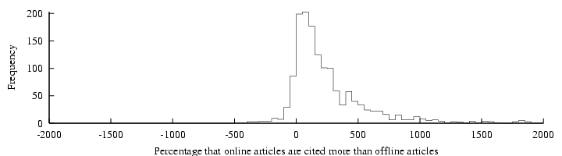
“Online or Invisible?” (Lawrence 2001)
“average of 336% more citations to online articles compared to offline articles published in the same venue”
Lawrence, S. (2001) Free online availability substantially increases a paper's impact Nature 411 (6837): 521.
http://www.neci.nec.com/~lawrence/papers/online-nature01/
Notes:
Lawrence’s study using articles in computer science, comparing articles from the same venue (mostly refereed conference proceedings, which is the main form of publication in computer science) and showing that the ones that were self-archived had 300% more citations than the ones in the same venue that were not self-archived.

Slide 7
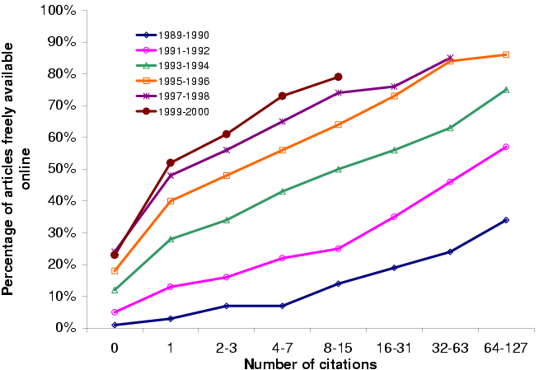
Lawrence (2001) findings for computer science conference papers. More OA every year for all citation levels; higher with higher citation levels
Notes:
The correlation between OA and citation level, for computer science

Slide 9
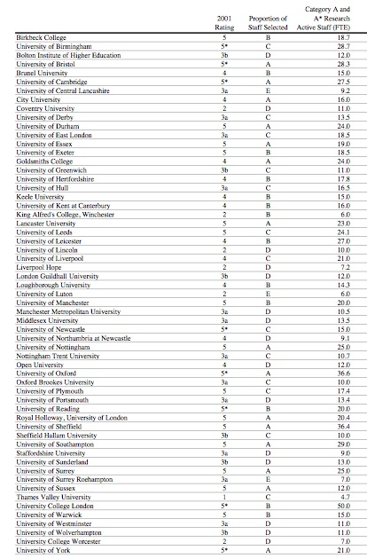
RAE 2001
Rankings for
Psychology

Slide 10
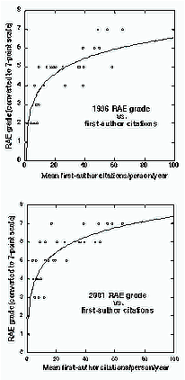
Research Assessment, Research Funding, and Citation Impact
“Correlation between RAE ratings and mean departmental citations +0.91 (1996) +0.86 (2001) (Psychology)”
“RAE and citation counting measure broadly the same thing”
“Citation counting is both more cost-effective and more transparent”
(Eysenck & Smith 2002)
http://psyserver.pc.rhbnc.ac.uk/citations.pdf
Notes:
The panel rankings are highly correlated with citation counts.
The exercise is based on submitting many performance indicators, and there is long, time-consuming assessment.
But the rank order can already predicted (with a correlation of 0.9) by simply counting the total citations.
This is true even though citation counts are not submitted.
Yet they could have replaced the whole RAE exercise, and much less cost in time and effort for all.
This illustrates the importance of citation impact for research funding.

Slide 11
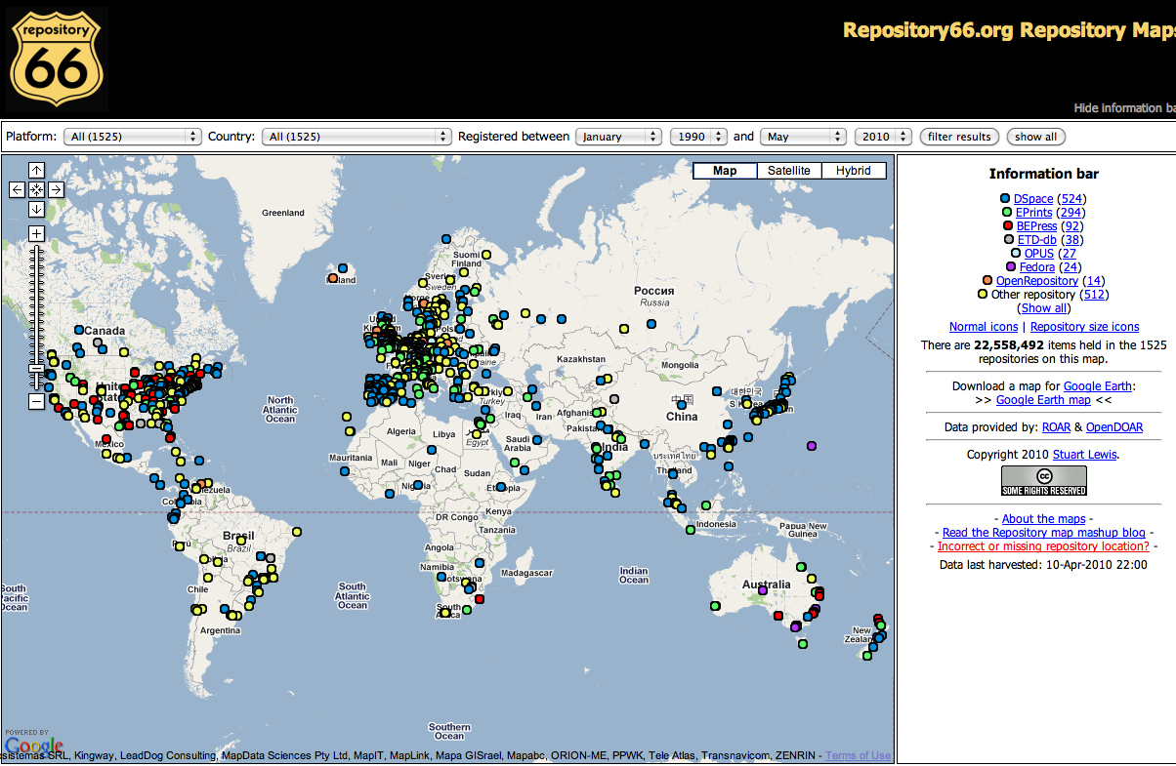
There are plenty of repositories

Slide 12
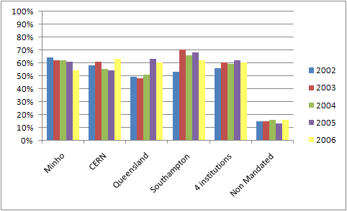
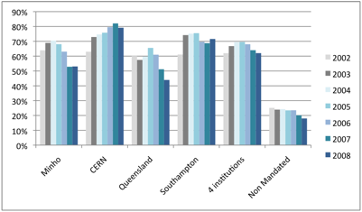
But almost all of them are almost-empty of OA’s target content (5-25%)
2002-2006
2002-2008

Slide 13
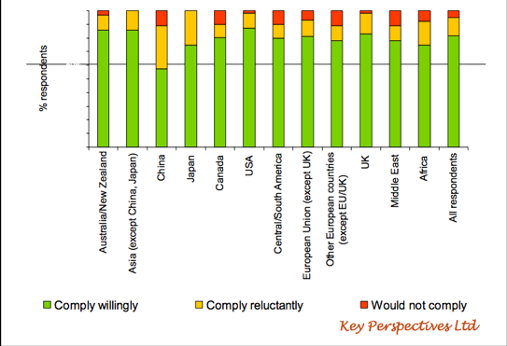
Author Surveys (Alma Swan)

Slide 14
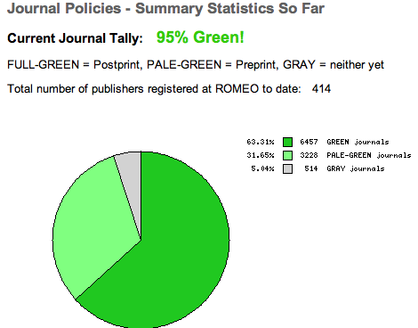

Slide 16
Benefit/Cost comparisons for the UK
(GBP millions over 20 years and benefit/cost ratio)
Note: Compares Open Access alternatives against subscription publishing of national outputs, with costs, savings and increased returns expressed in Net Present Value over 20 years (GBP millions). Returns are to public sector and higher education R&D spending. HE = Higher Education.
Centre for Strategic Economic Studies
Notes:
16

Slide 17
Scenario de transition
Politique d’autoarchivage obligatoire (universités et bailleurs de fonds)
OA vert à 100%
Annulations des abonnements aux revues
Fin de fournitutre des versions imprimées et en-ligne
Archivage par les dépôts institutionnels
Conversion à l’édition OA doré
Libération des fonds d’abonnement pour payer l’OA doré

Slide 18
Situation actuelle
Les fonds institutionnels pour la publication sont verrouillés dans les abonnements de revues de moins en moins abordable
Le coût de l’OA doré est inabordable – payer l’OA doré c’est payer double

Slide 19
http://www.crsc.uqam.ca/
http://users.ecs.soton.ac.uk/harnad/
Harnad, S. (2003) Cielographie et cielolexie: Anomalie post-gutenbergienne et comment la resoudre. Origgi, G. & Arikha, N. (dir) Le texte a l'heure de l'Internet. Bibliotheque Centre Pompidou: Pp. 77-103. http://www.ecs.soton.ac.uk/~harnad/Temp/texte2.pdf
Harnad, S. (200v) Retour a la tradition orale: ecrire dans le ciel a la vitesse de la pensee. Salaun, Jean-Michel & Vandendorpe, Christian (dir). Le deis de la publication sur le web: hyperlectures, cybertextes et meta-editions. Presses de l'enssib.
http://eprints.ecs.soton.ac.uk/7723/

